Slide 1
LiveGaze
Landing page slide sequence
Introduces the problem sharing ways of seeing
Explains what LiveGaze is made of and how it works general principles)
Explains how LliveGaze solves the problem

Slide 2
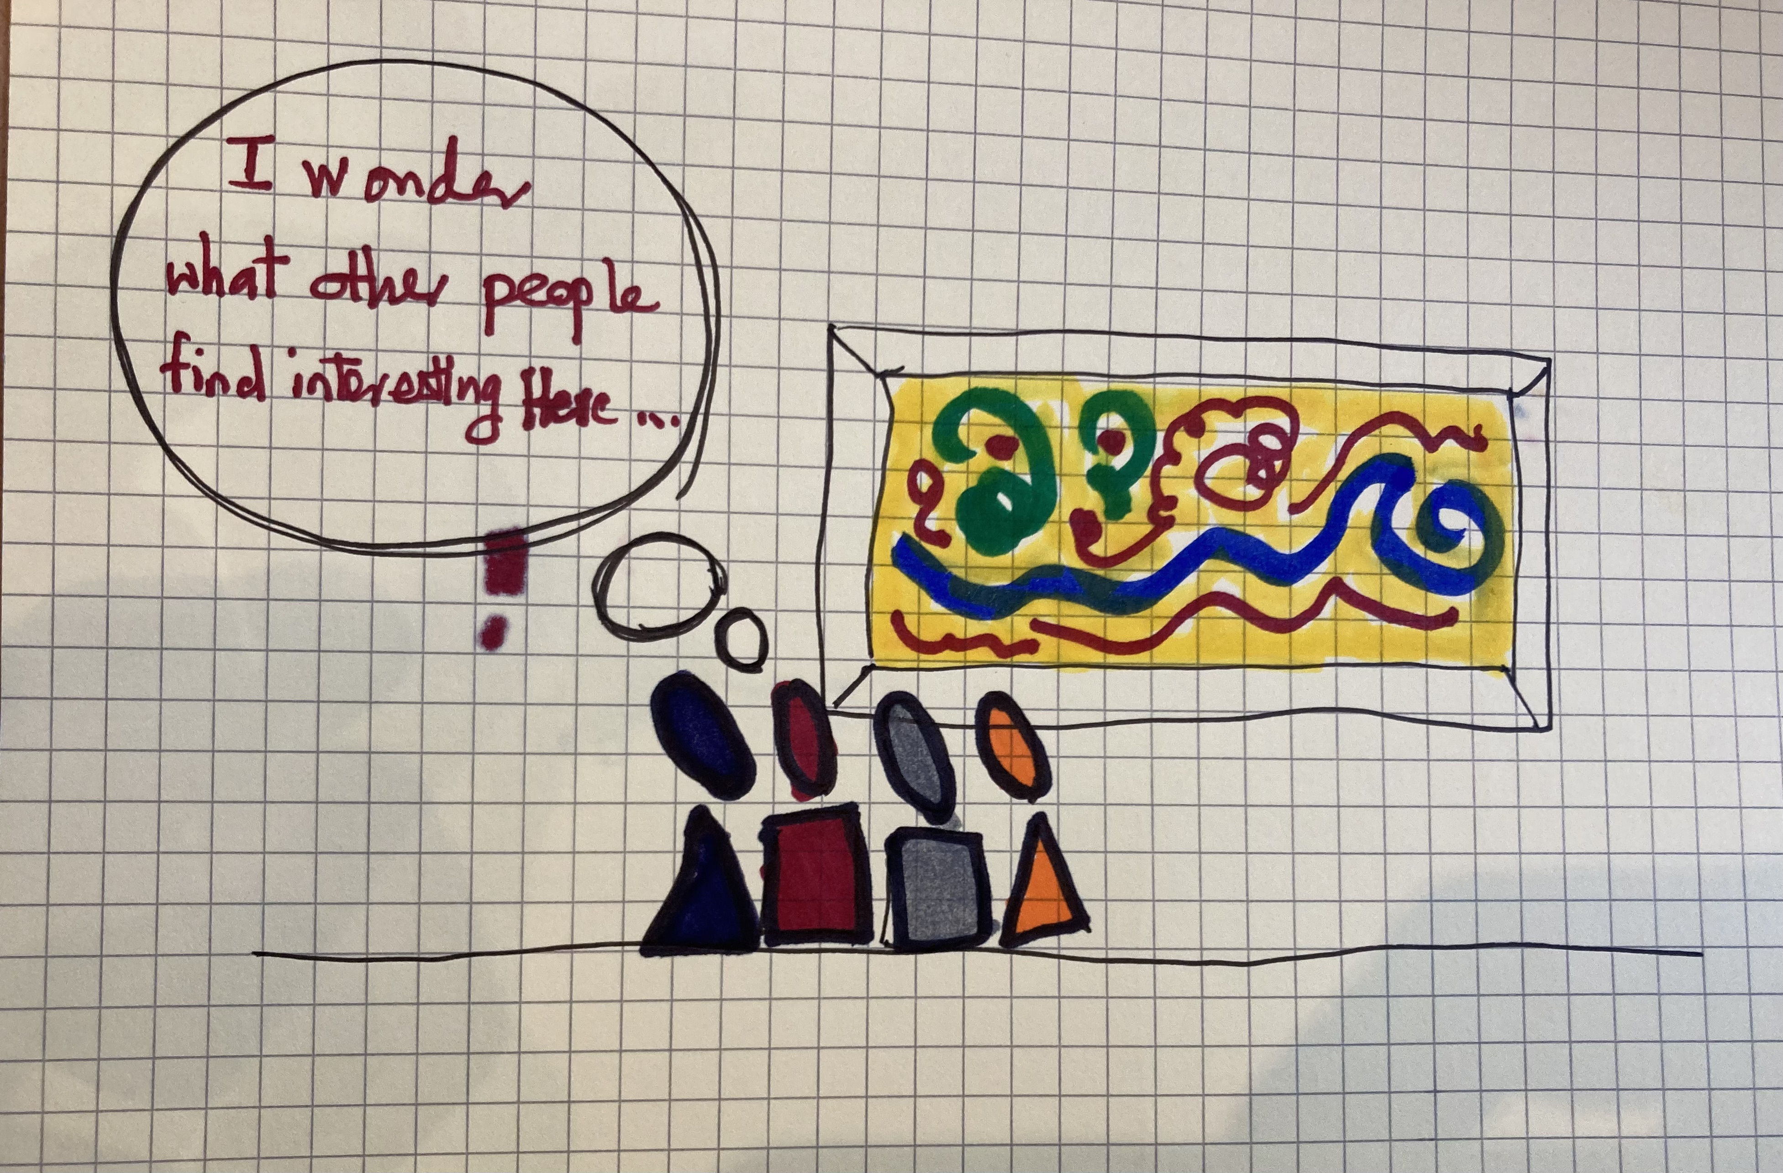
Visitors to a gallery
Visitors are standing in front of a famous painting (Van Gogh Starry Nights, Da Vinci’s Monalisa, etc)
One visitor is asking: “I wonder what other people find interesting in this painting?”

Slide 3
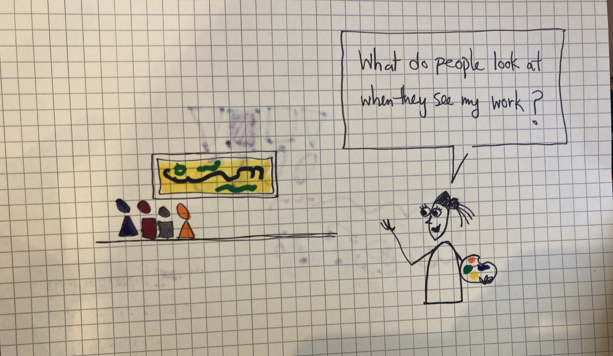
The Artist
We zoom out one level
We see the artist standing in foreground, in the background we see the same group of visitors and the painting
The artist asks: “I wonder what people look at when then they see my work?”

Slide 4
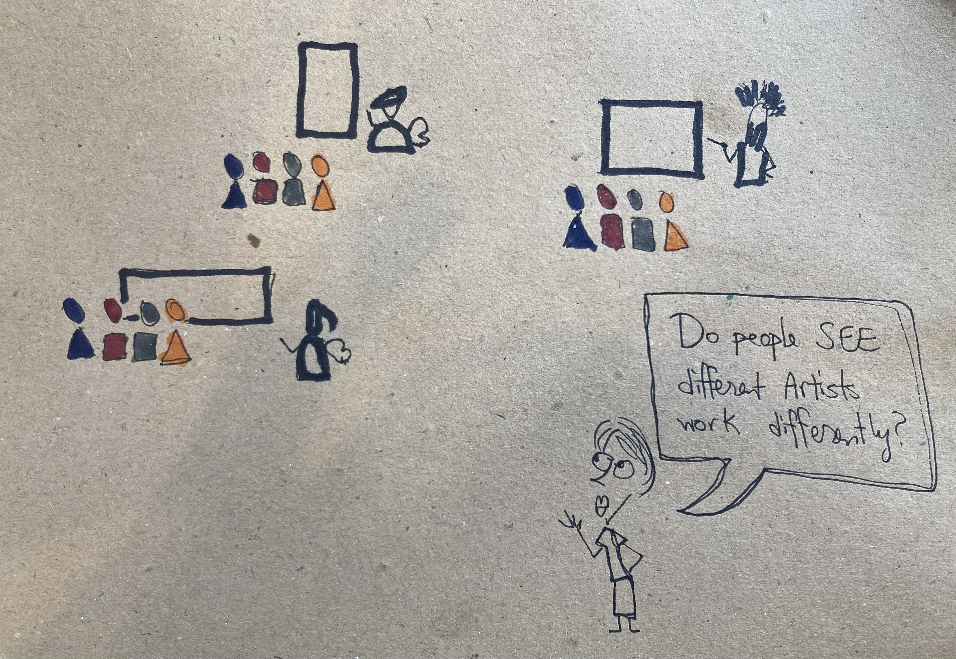
Art Scholar
We zoom out one further level
We see the a scholar of art history standing in foreground. In the background we see three groups, each with one Artist, and the group of visitors and the painting
The artist asks: “Do people SEE different artists differently?”

Slide 5
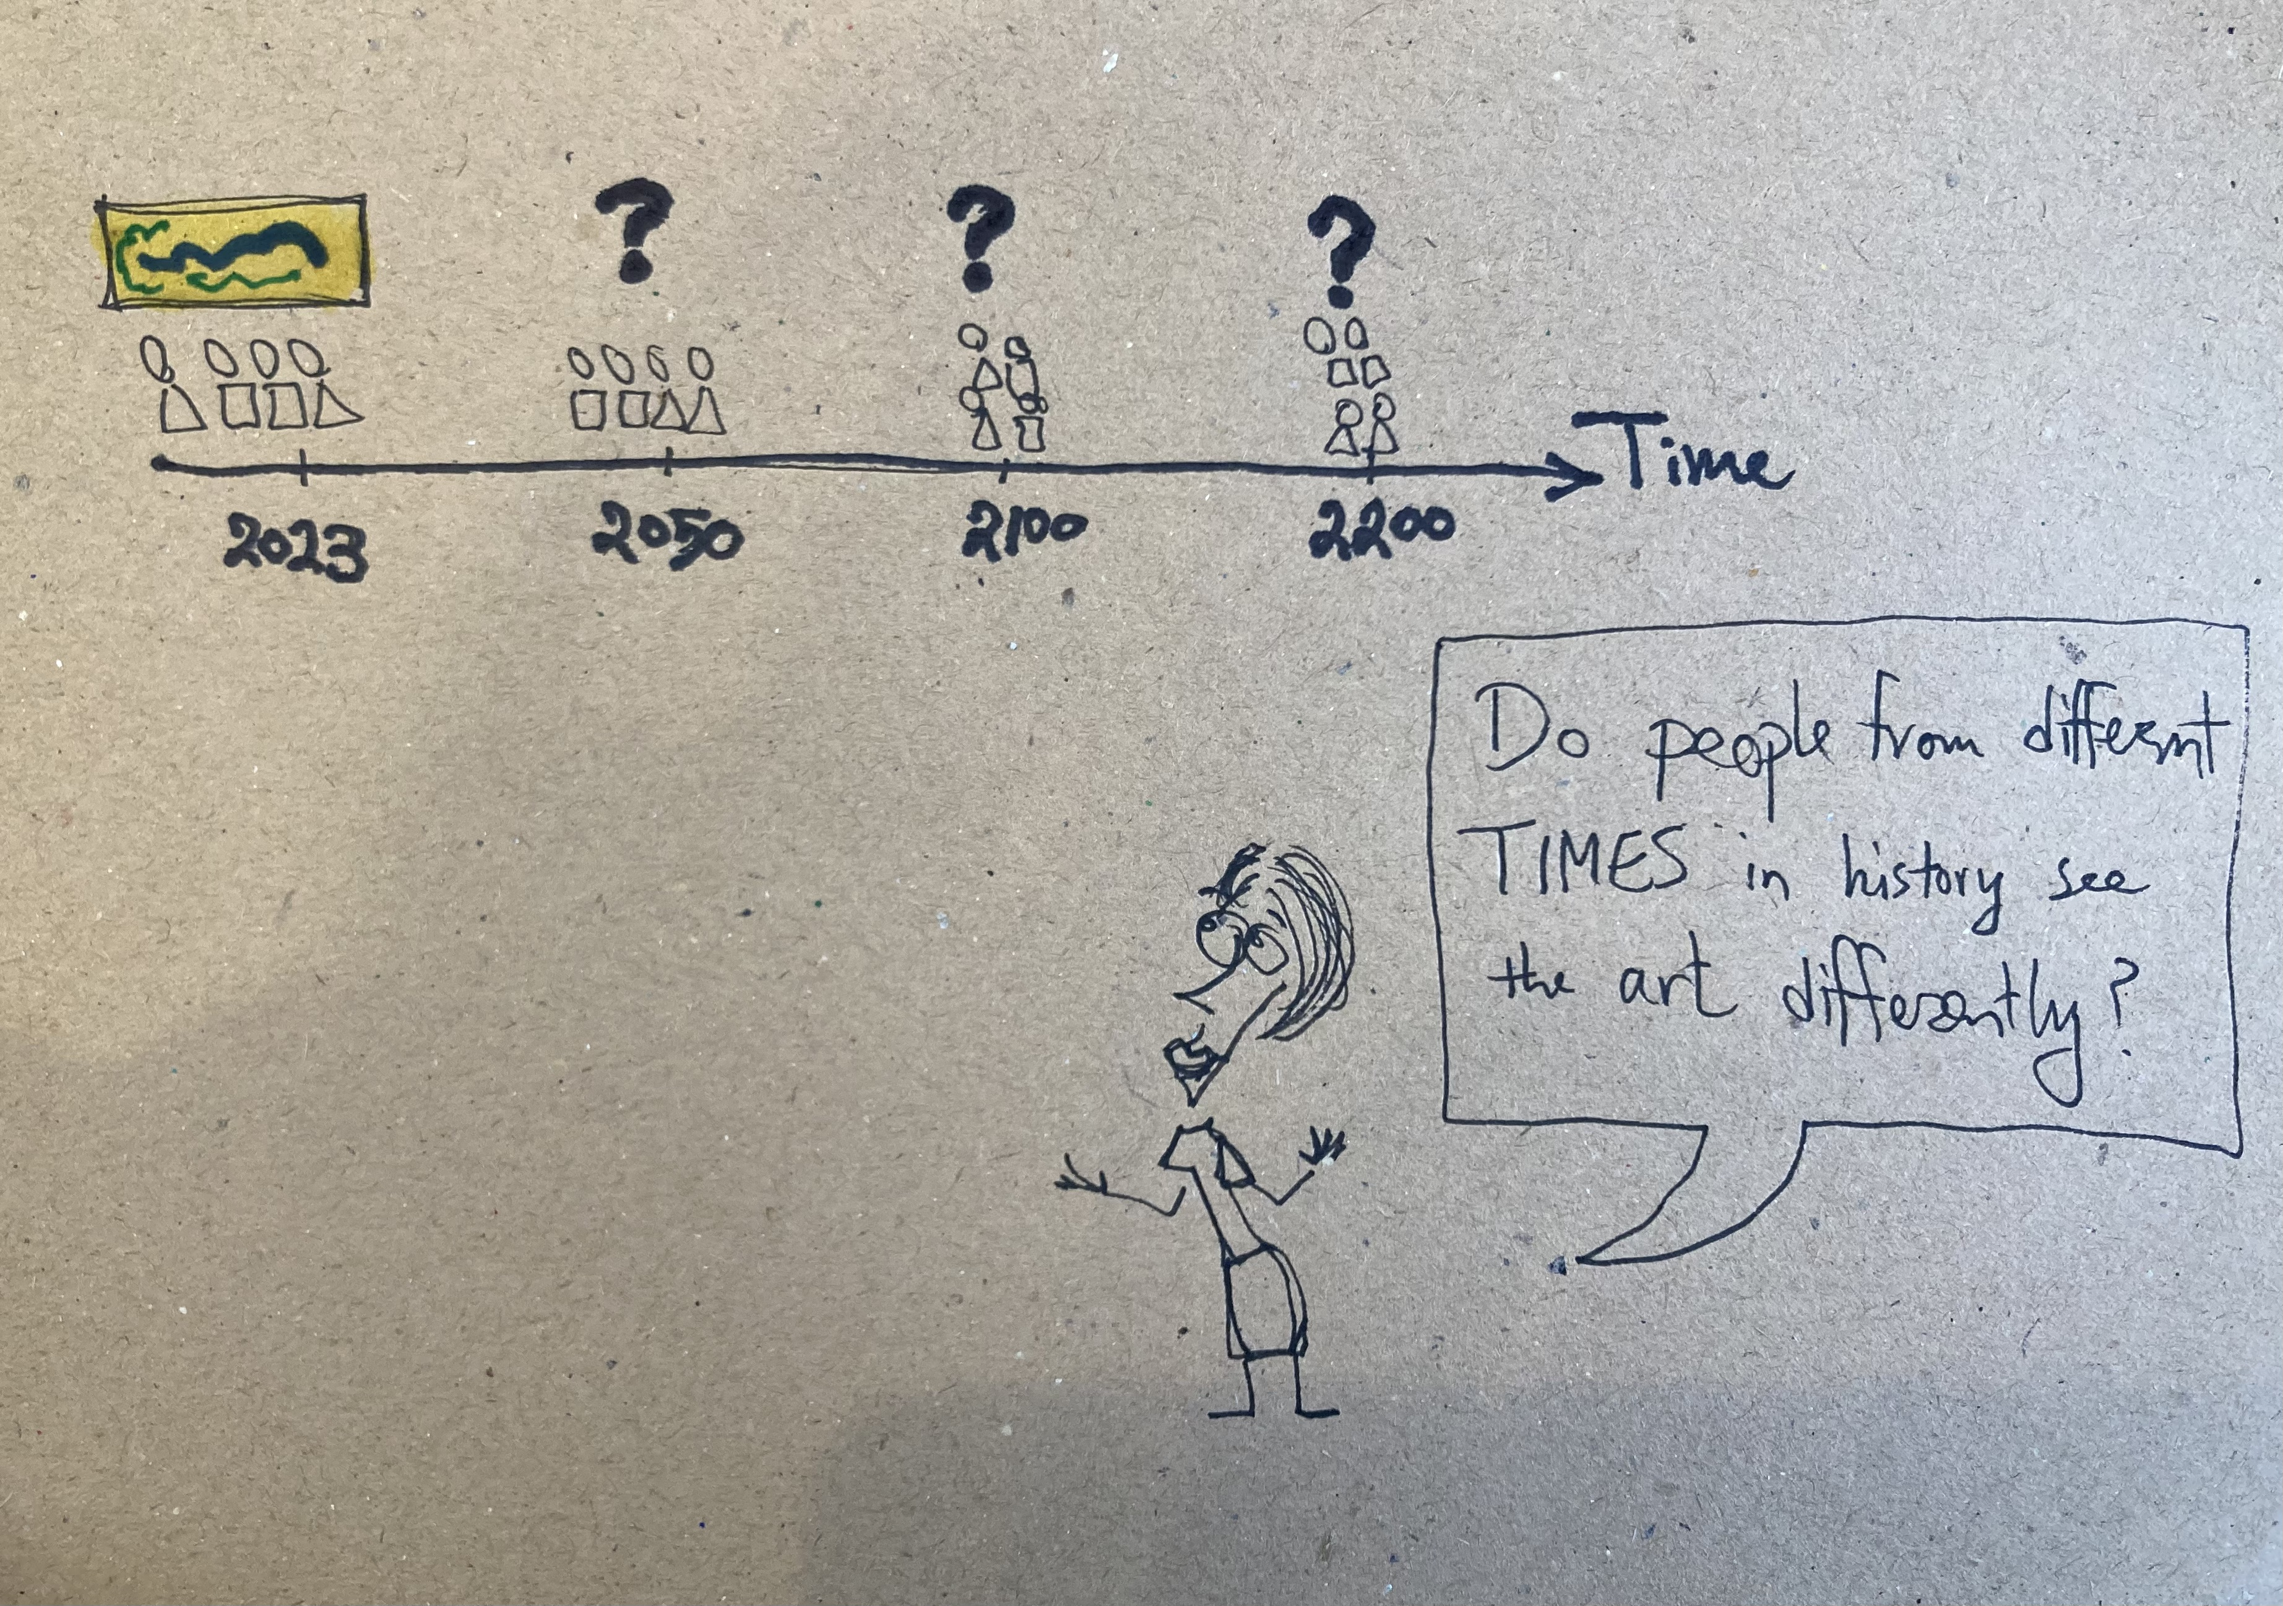
Art History
We see the a scholar of art history standing in foreground. In the background we see three groups of visitors from three different times, all with the same Artist.
The artist asks: “Do people from different times in history see the same art differently?”
Is it possible to record and archive the HISTORY OF SEEING?

Slide 6
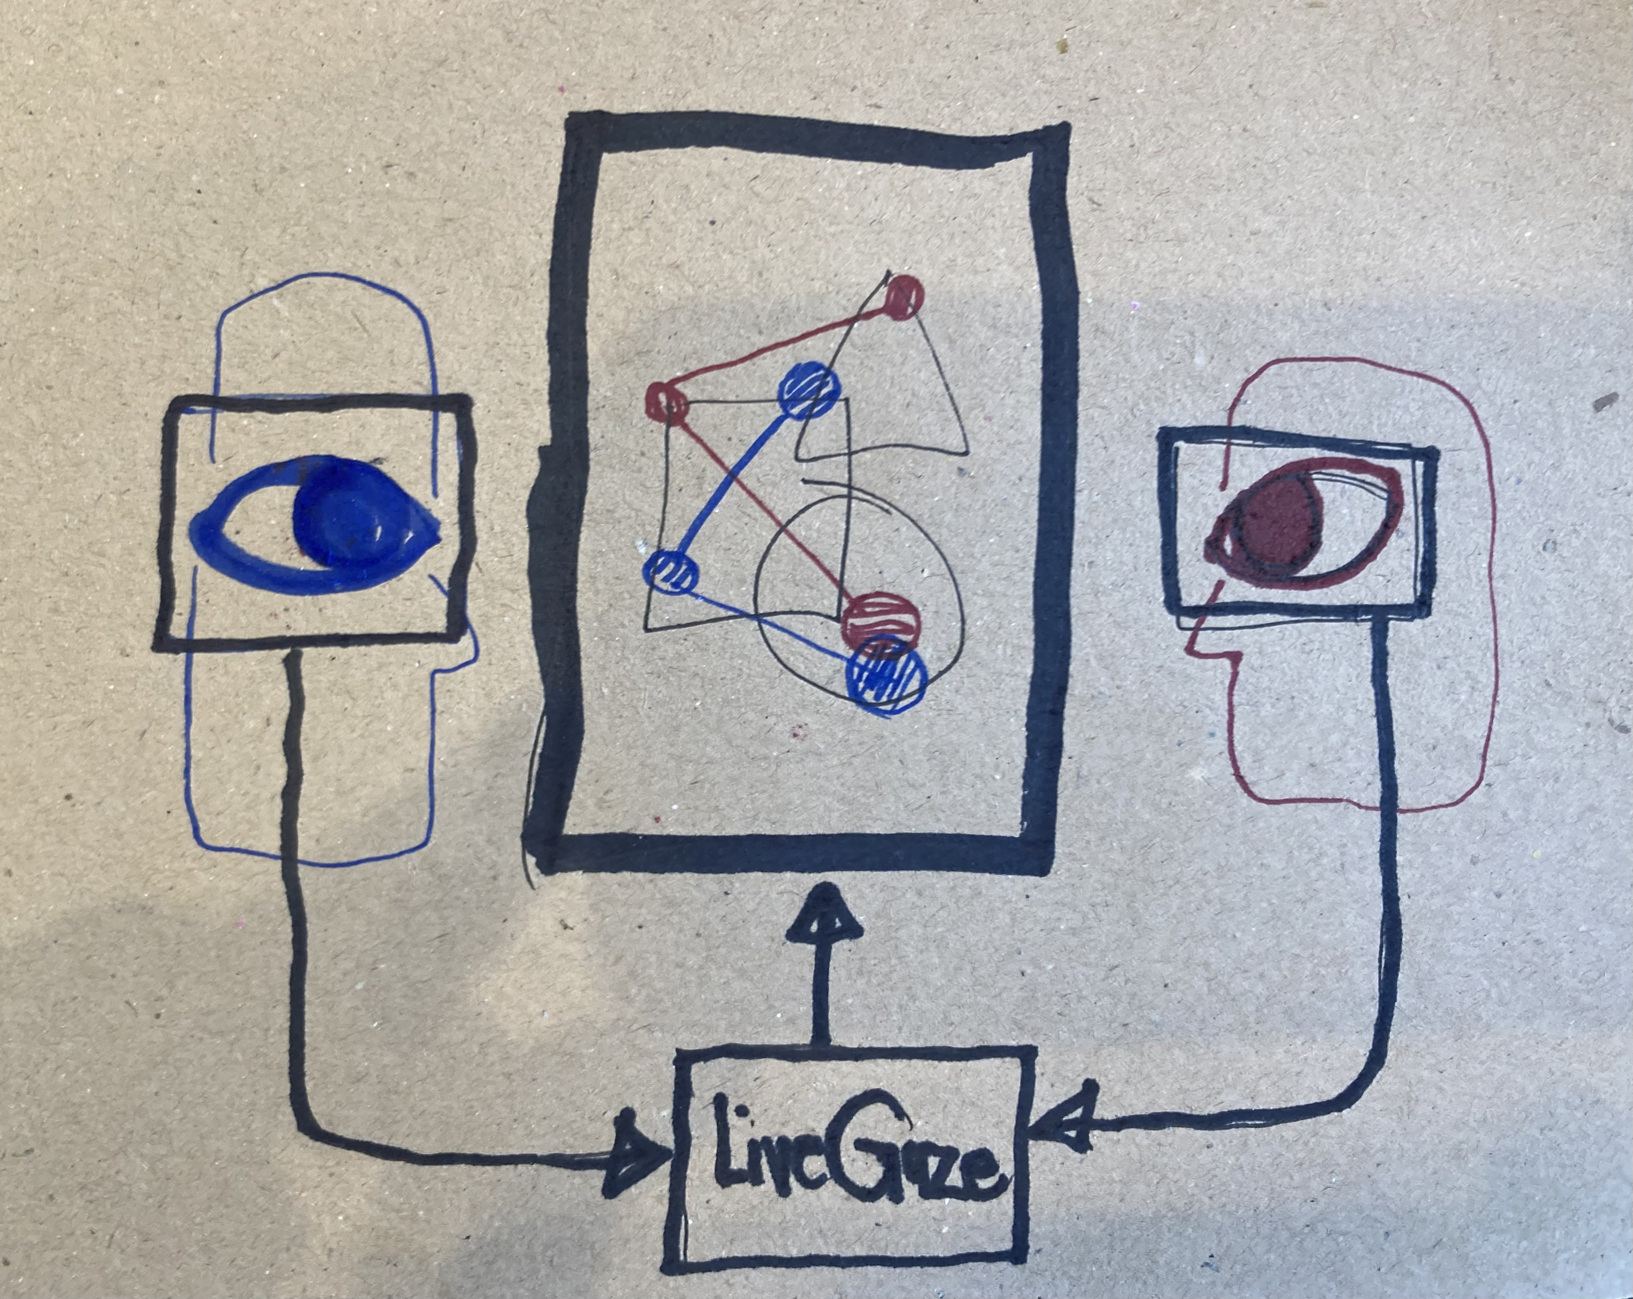
To answer these questions, we introduce LiveGaze
An augmented reality platform for collective visual interactions

Slide 7
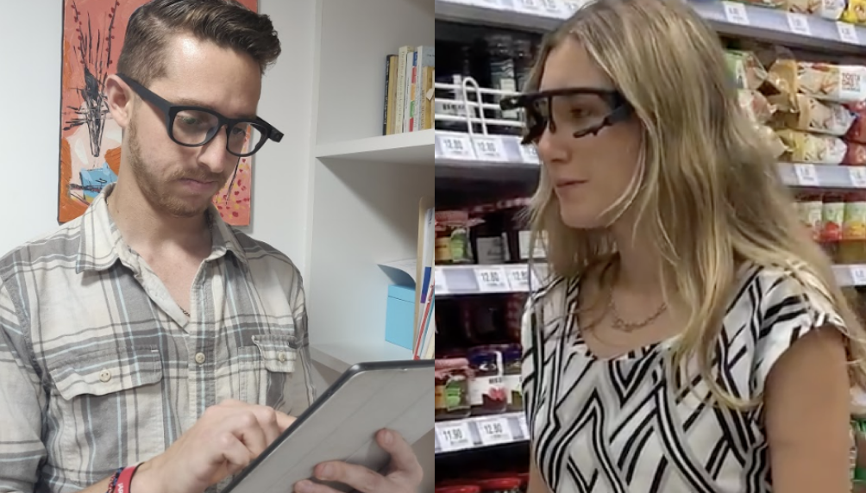
LiveGaze
Unobtrusive experience sampling with state-of-the-art mobile eye tracking

Slide 8
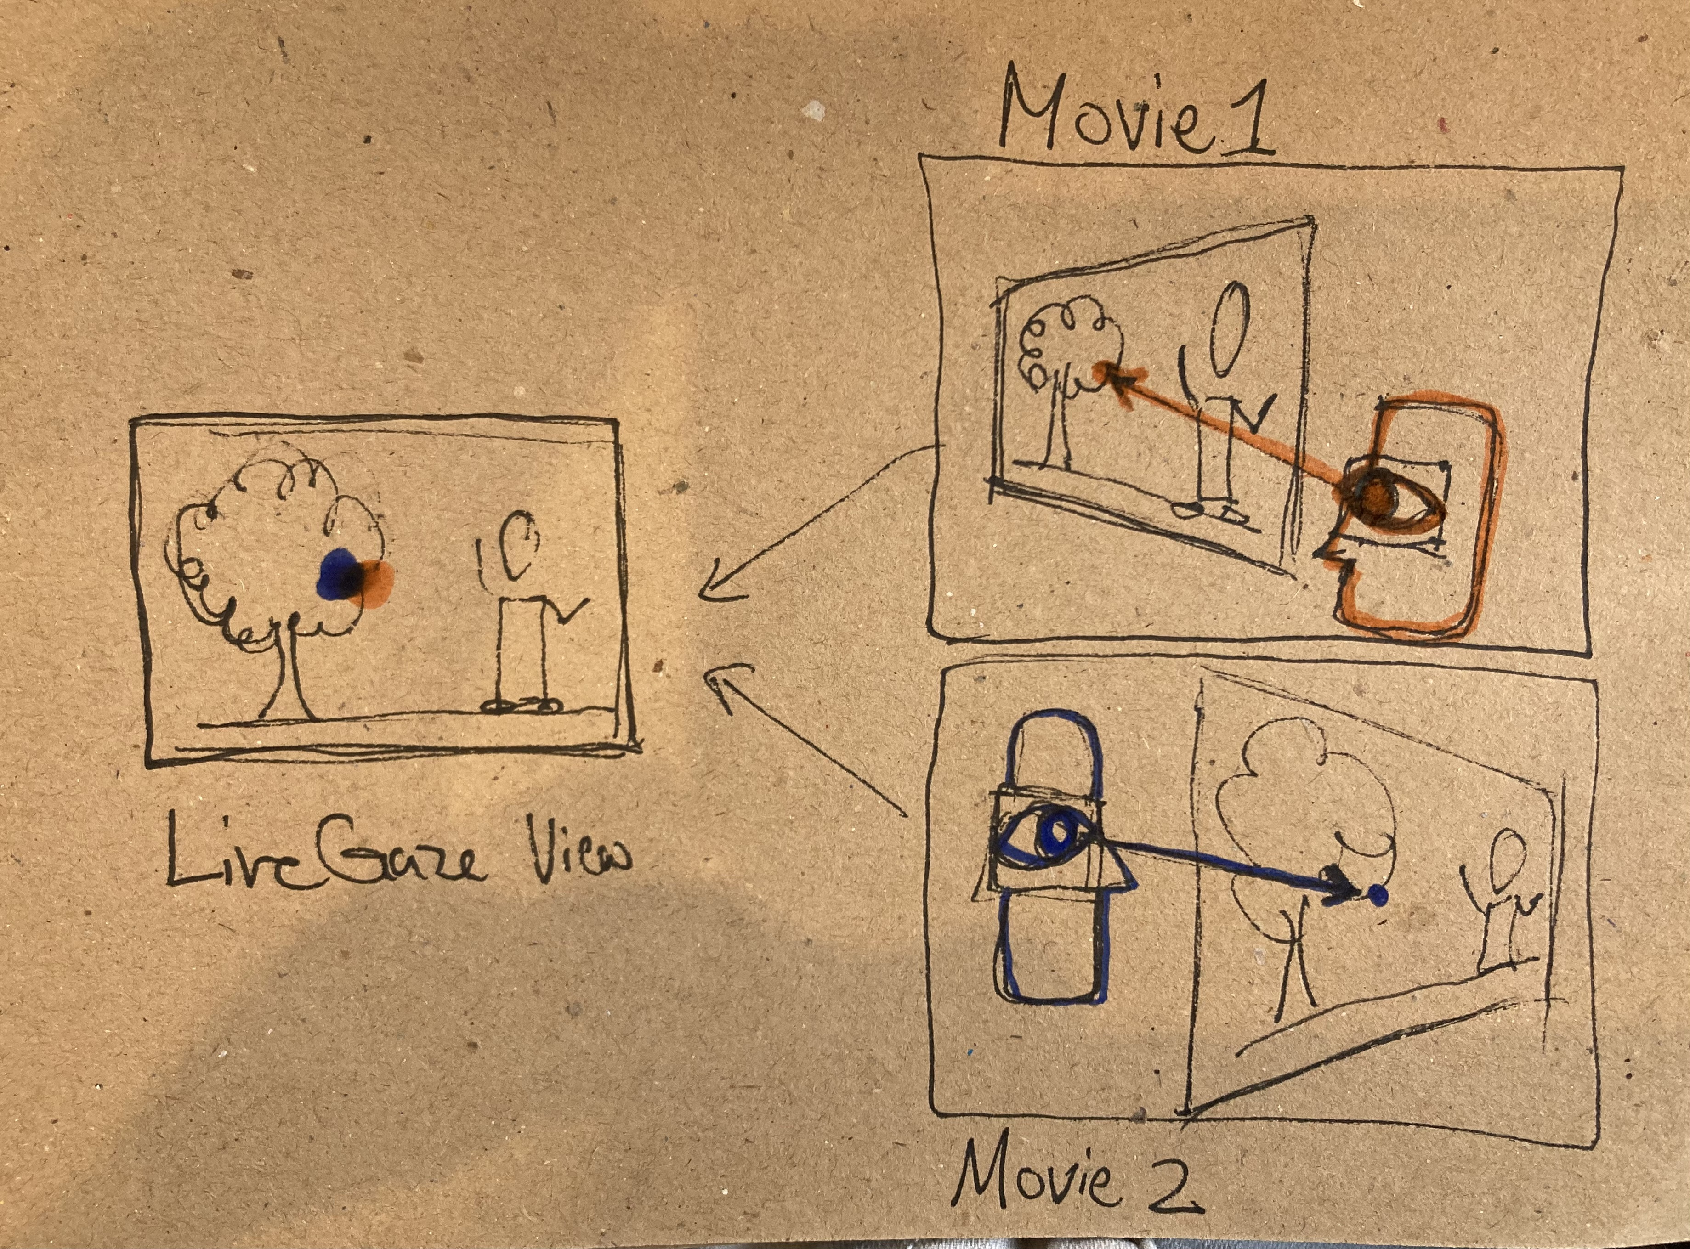
LiveGaze
Integrates different individual experiences into a commonly shared data frame.

Slide 9
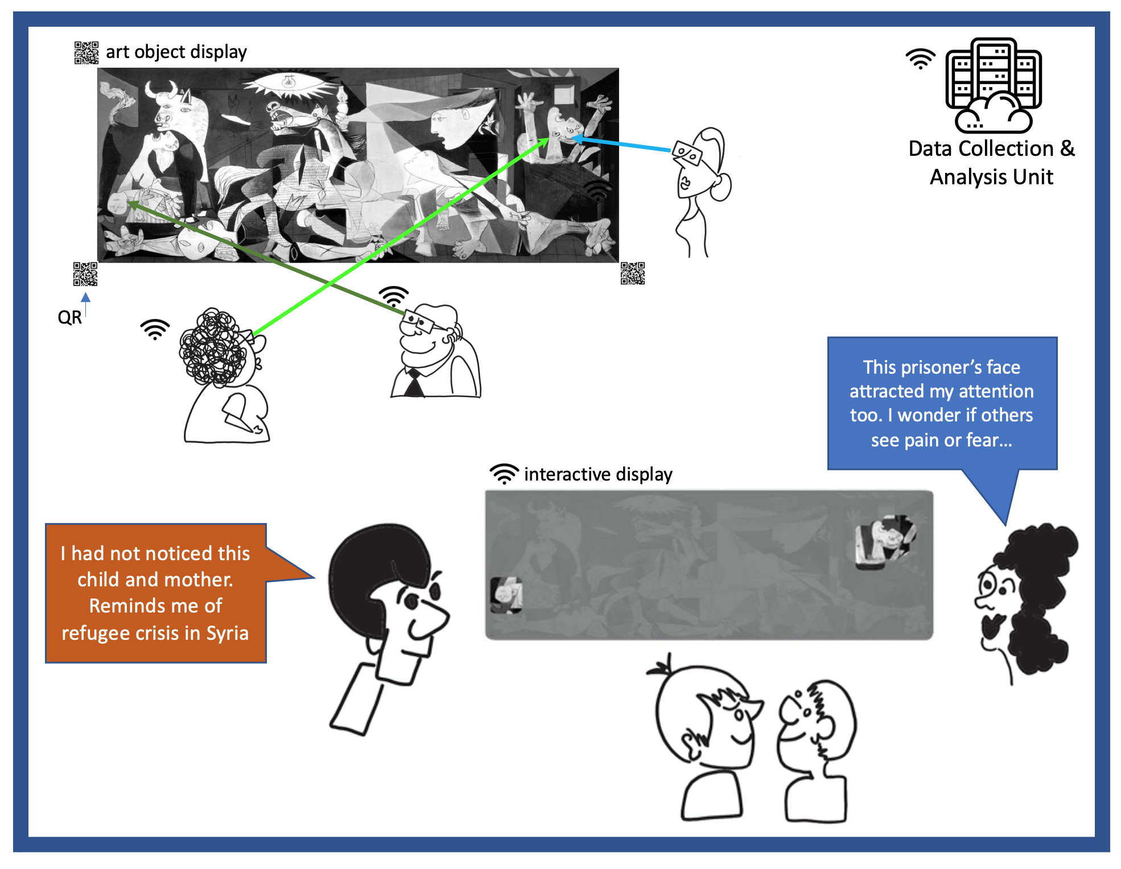
LiveGaze
This integrated experience of the group is projected back to them to share one another’s subjective point of view

